Slide 1
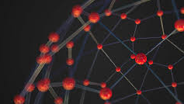

NODE CLUSTERING & GNNs FOR GRAPH ANALYSES
MARCO PETERS, NAMIR SACIC, PEDRO SUAREZ

Slide 2
CONTENT
1
Introduction & Topic Motivation
2
Graph Neural Networks
3
Data Set
4
Python: Code & Analysis
5
Cases

Slide 3
CONTENT
1
Introduction & Topic Motivation
2
2
Graph Neural Networks
3
3
Data Set
4
4
Python: Code & Analysis
5
Cases

Slide 4
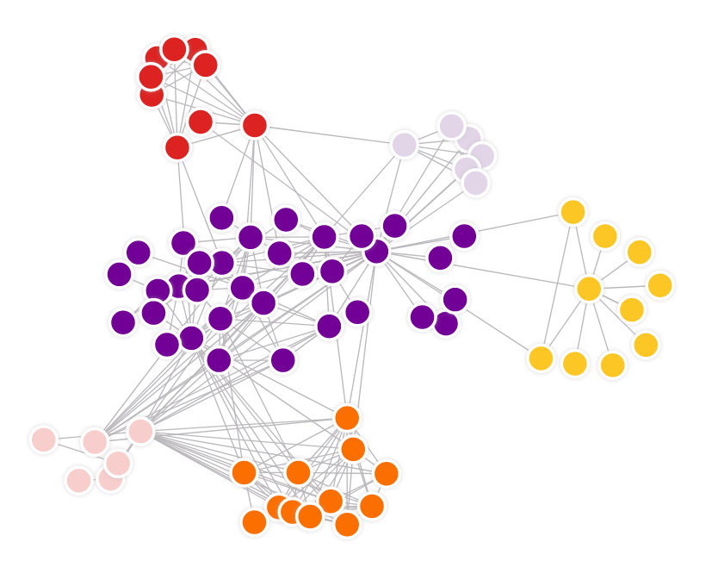
Introduction & Topic Motivation
Node Clustering
Graphs find application in many areas, e.g.:
Social Networks
Transportation networks
Others
For example: In social networks, nodes may represent users and their labels describe their profile
Grouping or partitioning nodes in a graph into clusters or communities based on structural properties and similarities
Clustering can be the basis for social studies or user recommendations
Question: How can we cluster a graph to identify nodes with similar characteristics?
4

Slide 5
CONTENT
1
Introduction & Topic Motivation
2
2
Graph Neural Networks
3
3
Data Set
4
4
Python: Code & Analysis
5
Cases

Slide 6
Important Terminology
Recurrent Neural Networks (RNNs): are neural networks that can process sequential or time-dependent data. They have a memory that allows them to remember past information and use it to influence current predictions. They are good for tasks where the order of data matters, like predicting the next word in a sentence or analysing time-series data.
Graph Neural Networks (GNNs): are neural networks designed to process data structured as a graph. Graphs consist of nodes connected by edges, like social networks or road networks. GNNs can capture complex relationships and dependencies between nodes in a graph. They are useful for tasks involving graphs, such as social network analysis, recommendation systems, or modelling traffic flow in road networks.
In the given case, GNNs were used because they are specifically designed for processing graph-structured data like road networks. They can capture the connectivity structure of the roads and model how traffic flows through the network. GNNs allow for considering connections between adjacent roads, intersections, and other dependencies, which is crucial for accurately predicting travel times in such complex scenarios.

Slide 7
CONTENT
1
Introduction & Topic Motivation
2
2
Graph Neural Networks
3
3
Data Set
4
4
Python: Code & Analysis
5
Cases

Slide 8
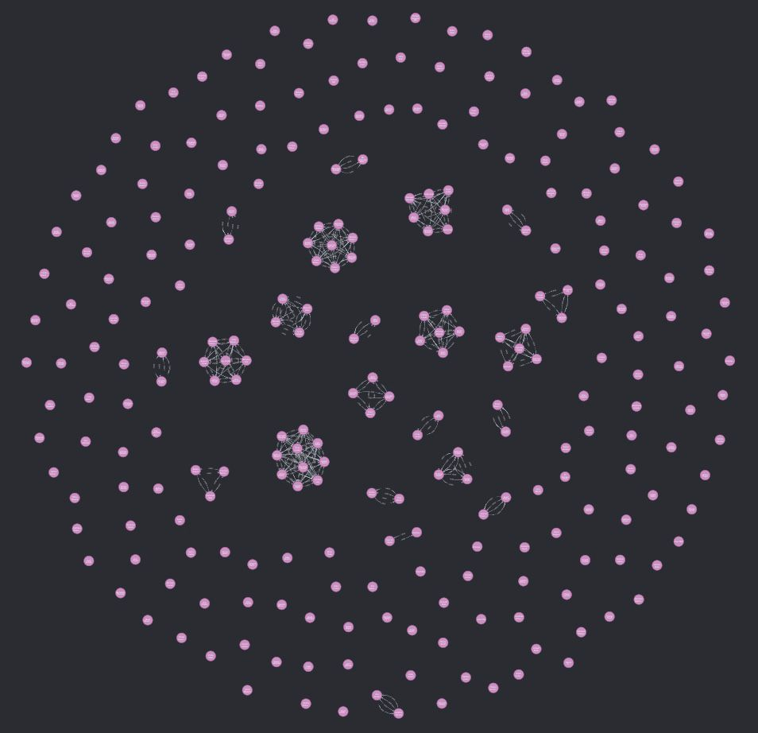
Data Set & Data Generation
254 nodes representing users
1,000 edges representing connections, w/ weights
1 = like
0 = dislike
Features:
ID
Name
Age
Hobbies
Political Orientation
Relationship type (friends / no friends)
Neo4J Graph Visualization

Slide 9
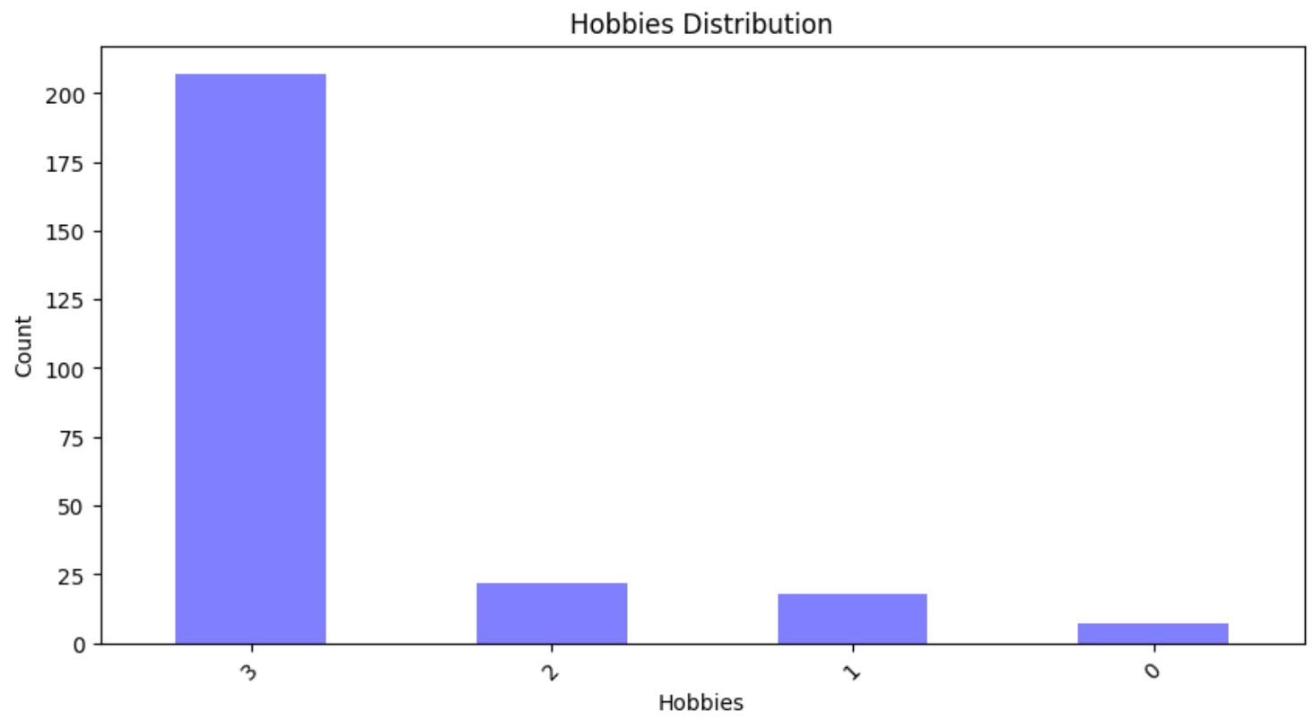
Data Set & Data Generation
0: Gaming & Painting & Reading
1: Gaming & Reading
2: Painting & Photography
3: Reading

Slide 10
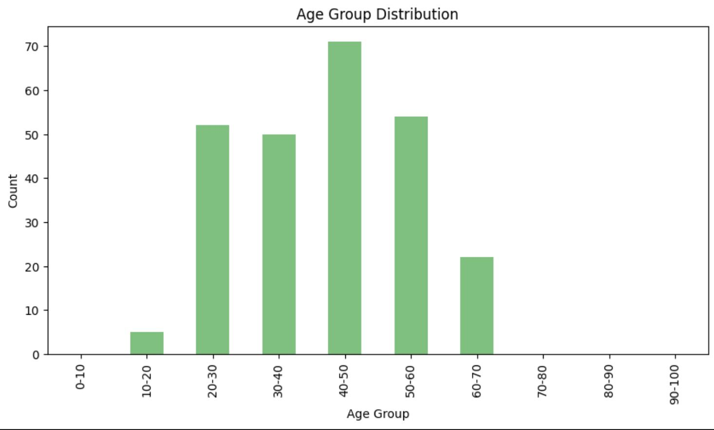
Data Set & Data Generation

Slide 11
CONTENT
1
Introduction & Topic Motivation
2
2
Graph Neural Networks
3
3
Data Set
4
4
Python: Code & Analysis
5
Cases

Slide 12
CONTENT
1
Introduction & Topic Motivation
2
2
Graph Neural Networks
3
3
Data Set
4
4
Python: Code & Analysis
5
Cases

Slide 13
Important Terminology
Recurrent Neural Networks (RNNs): are neural networks that can process sequential or time-dependent data. They have a memory that allows them to remember past information and use it to influence current predictions. They are good for tasks where the order of data matters, like predicting the next word in a sentence or analysing time-series data.
Graph Neural Networks (GNNs): are neural networks designed to process data structured as a graph. Graphs consist of nodes connected by edges, like social networks or road networks. GNNs can capture complex relationships and dependencies between nodes in a graph. They are useful for tasks involving graphs, such as social network analysis, recommendation systems, or modelling traffic flow in road networks.
In the given case, GNNs were used because they are specifically designed for processing graph-structured data like road networks. They can capture the connectivity structure of the roads and model how traffic flows through the network. GNNs allow for considering connections between adjacent roads, intersections, and other dependencies, which is crucial for accurately predicting travel times in such complex scenarios.

Slide 14
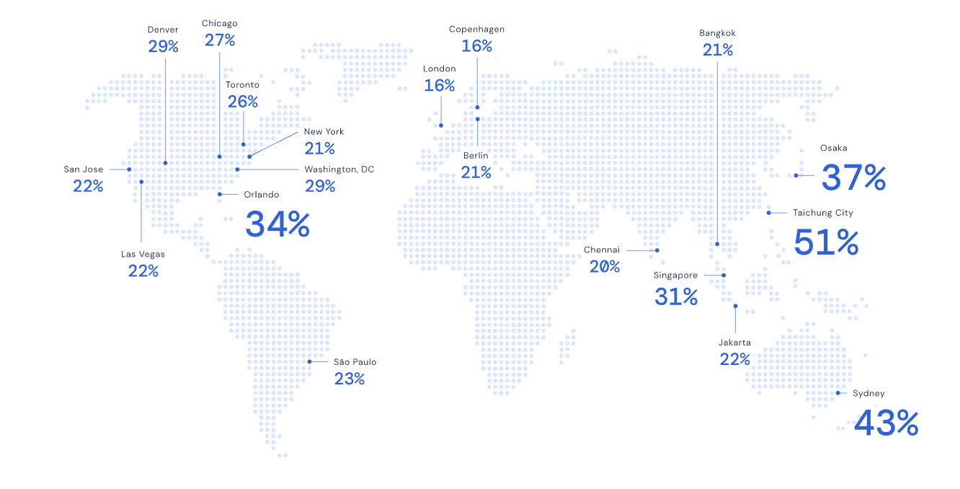
How Google Maps Predicts ETAs
Goal:
Predict future traffic
Limitations:
Combining live traffic conditions with historical traffic patterns for roads worldwide.
Solution:
To do this at a global scale, we used a generalised machine learning architecture called Graph Neural Networks.

Slide 15
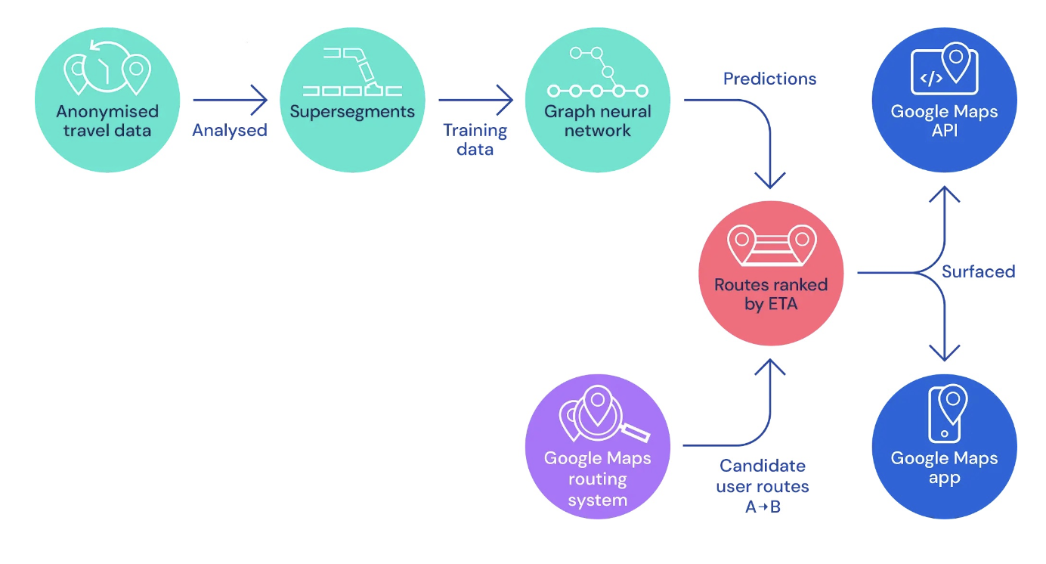
Dividing the World’s Roads Into “Supersegments”
Google Maps prediction System:
A route analyser that processes terabytes of traffic information to construct Supersegments.
A novel Graph Neural Network model, which is optimised with multiple objectives and predicts the travel time for each Supersegment.
Notes:
allows us to conduct spatiotemporal reasoning by incorporating relational learning biases to model the connectivity structure of real-world road networks. Here’s how it works:

Slide 16

How do we represent dynamically sized examples of connected segments with arbitrary accuracy in such a way that a single model can achieve success?
Approach:
Train a single fully connected neural network model for every Supersegment.
Recurrent Neural Networks (RNNs)
Graph Neural Networks
Solution:
Since the interest was in how cars flow through a network of roads, and Graph Neural Networks can model network dynamics and information propagation.
Result: generalising the concept of “proximity”, allowing us to have arbitrarily complex connections to handle not only traffic ahead or behind us, but also along adjacent and intersecting roads.
Notes:
Our model treats the local road network as a graph, where each route segment corresponds to a node and edges exist between segments that are consecutive on the same road or connected through an intersection. In a Graph Neural Network, a message passing algorithm is executed where the messages and their effect on edge and node states are learned by neural networks. From this viewpoint, our Supersegments are road subgraphs, which were sampled at random in proportion to traffic density. A single model can therefore be trained using these sampled subgraphs, and can be deployed at scale.

Slide 17
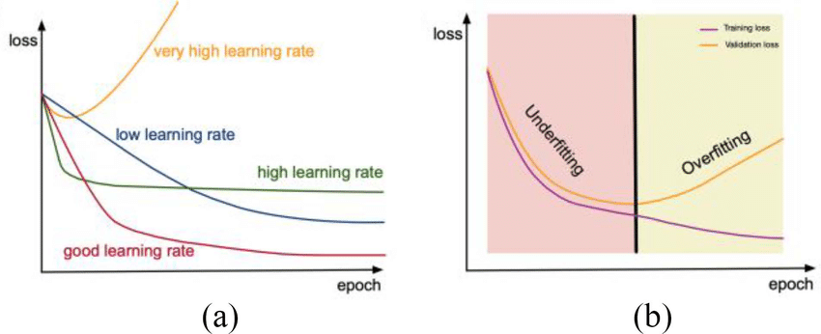
From Basic Research to Production-Ready Machine Learning Models
We discovered that Graph Neural Networks are particularly sensitive to changes in the training curriculum - the primary cause of this instability being the large variability in graph structures used during training.
Researchers often reduce the learning rate of their models over time, as there is a tradeoff between learning new things, and forgetting important features already learned
the most successful approach to this problem was using MetaGradients (gradients of gradients) to dynamically adapt the learning rate during training.
Notes:
By automatically adapting the learning rate while training, our model not only achieved higher quality than before, it also learned to decrease the learning rate automatically. This led to more stable results, enabling us to use our novel architecture in production.

Slide 18
Making Models Generalise Through Customized Loss Functions
Using a linear combination of multiple loss functions (weighted appropriately) greatly increased the ability of the model to generalise.
We formulated a multi-loss objective making use of a regularising factor on the model weights, L_2 and L_1 losses on the global traversal times
Result: avoided Overfitting

